Slide 1
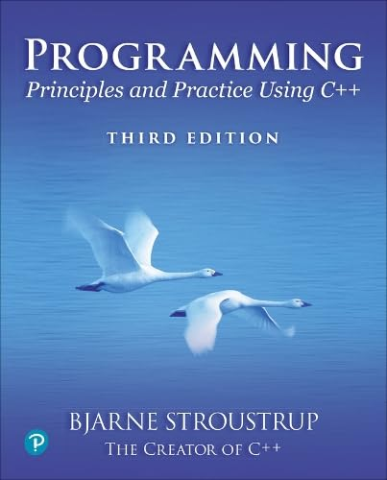
Chapter 1 – Hello, World!
Programming is learned
by writing programs.
– Brian Kernighan
Notes:
Imagine that you are standing in front of a class of students. Some have never programmed before. Some have learned a variety of good and bad programming from the Web. Some think they know everything. What can you tell them to get them interested to learn systematically and constructively.

Slide 2
To the teacher
Imagine that you are standing in front of a class of students. Some have never programmed before. Some have learned a variety of good and bad programming from the Web. Some think they know everything. Some are used to be smarter than their computing teacher. What can you tell them to get them interested to learn systematically and constructively?
I consider it essential to set expectations. 90% of lecture #1 slides aim at that.
There is too little code here, but once you have added “local information” (grading, TA support, rooms, …) there will be little time left out of a standard lecture slot.
If there is more time
Maybe show a video about the key role of software in the world
something the students can relate to
I recommend against showing a game or anything with weapons. That puts off some excellent students
Maybe start on lecture #2
These slides were written assuming two about-50-minute-long lectures a week for 11 weeks
More time could/should be used for projects, review, and “added material” (e.g., from the PPP2 chapters)
I make no assumptions about what tests, exams, and other material you might have

Slide 3
Abstract
Today, we’ll outline the aims for this course and present a rough course plan. We’ll introduce the basic notion of programming and give examples of areas in which software is critical to our civilization. Finally, we’ll present the simplest possible C++ program and outline how it can be made into running code.

Slide 4
Overview
Course aims and outline
Uses of software
The first program: "Hello, world!"
Compilation
What is programming?

Slide 5
This is a course
In Programming
For beginners
who want to become professionals
i.e., people who can produce systems that others will be happy using
who are assumed to be bright
Though not (necessarily) geniuses
who are willing to work hard
Though do need sleep occasionally, and take a normal course load
Using the C++ programming language

Slide 6
Not!
A Washout course
“If you can get into the science/engineering parts of a university, you can handle this course”
A course in
The C++ programming language
For students
who want to become language lawyers
We try not to get bogged down in technical obscurities
who are assumed to be a bit dim and fairly lazy
We try not to spoon feed
Using
Some untested software development methodologies and a lot of unnecessarily long words

Slide 7
The Aims
Teach/learn
Fundamental programming concepts
Key useful techniques
Basic Standard C++ facilities
After the course, you’ll be able to
Write small colloquial C++ programs
Read much larger programs
Learn the basics of many other languages by yourself
Proceed with an “advanced” C++ programming course
After the course, you will not (yet) be
An expert programmer
A C++ language expert
An expert user of advanced libraries

Slide 8
The Means
Lectures
Attend every one
Notes/Chapters
Read a chapter ahead (about one per lecture)
Read the chapter again after each lecture
Feedback is welcome (typos, bugs, suggestions, etc.)

Slide 9
The Means (Cont.)
Work
Review questions in chapters
Review “Terms” in Chapters
Drills
Always do the drills
Always do the drills before the exercises
Exercises
Course specific
Projects
That’s where the most fun and the best learning takes place
Quizzes
Exams

Slide 10
Cooperate on Learning
Except for the work you hand in as individual contributions, we strongly encourage you to collaborate and help each other
If in doubt if a collaboration is legitimate: ask!
Don’t claim to have written code that you copied from others
Don’t give anyone else your code (that you are to hand in for a grade)
When you rely on the work of others, explicitly list all of your sources – i.e., give credit to those who did the work
Don’t study alone when you don’t have to
Form study groups
Do help each other (without plagiarizing)
Go to your TA's office hours
Go prepared with questions
The only stupid questions are the ones you wanted to ask but didn’t

Slide 11
Rough course outline
Part I: The basics
Types, variables, strings, console I/O, computations, errors, vectors, functions, source files, modules, classes
Part II: Input and Output
Text I/O
Graphical output
Graphical User Interface
Part III: Data structures and algorithms
Free store, pointers, and arrays
Lists, maps, sorting and searching, vectors, templates
The STL
Part IV: Broadening the view (Web only, possibly just self study)
Software ideals and history
Text processing, numerics, embedded systems programming, testing, C, etc.

Slide 12
Rough course outline (Cont.)
Throughout
Program design and development techniques
C++ language features
Background and related fields, topics, and languages

Slide 13
Promises
Detail: We will try to explain every construct used in this course in sufficient detail for real understanding
There is no “magic”
Utility: We will try to explain only useful concepts, constructs, and techniques
We will not try to explain every obscure detail
Completeness: The concepts, constructs, and techniques can be used in combination to construct useful programs
There are, of course, many useful concepts, constructs, and techniques beyond what is taught here

Slide 14
More Promises
Realism: The concepts, constructs, and techniques can be used to build “industrial strength” programs
i.e., they have been used to …
Simplicity: The examples used are among the simplest realistic ones that illustrate the concepts, constructs, and techniques
Your exercises and projects will provide more complex examples
Scalability: The concepts, constructs, and techniques can be used to construct large, reliable, and efficient programs
i.e., they have been used to …

Slide 15
Feedback request
Please mail questions and constructive comments to
???
Your feedback will be most appreciated
Style, contents, detail, examples, clarity, conceptual problems, exercises, missing information, depth of presentation, etc.
Book support website
www.stroustrup.com/Programming
Local course support website
???

Slide 16
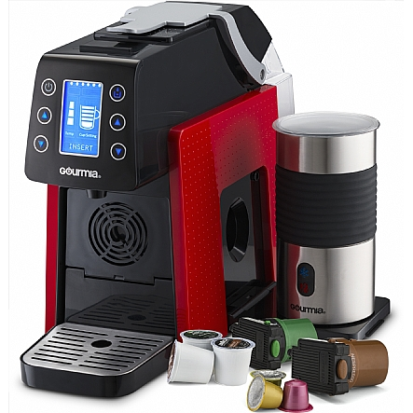
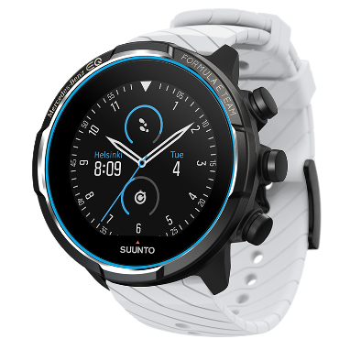
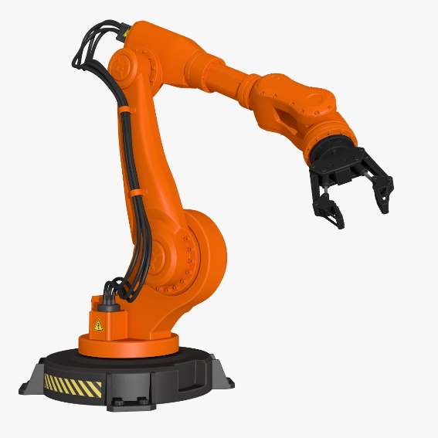
Why programming?
Our civilization runs on software
Most engineering activities involve software
Note: most programs do not run on things that look like a PC
a screen, a keyboard, a box under the table
Notes:
Divers’ watch. Coffee machine. Robot arm.

Slide 17
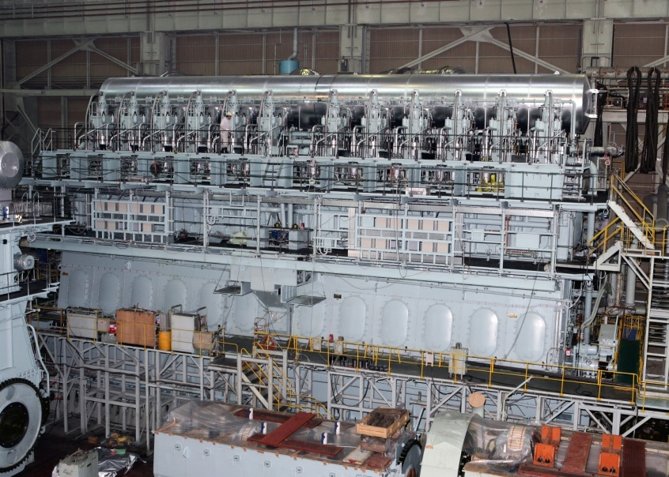
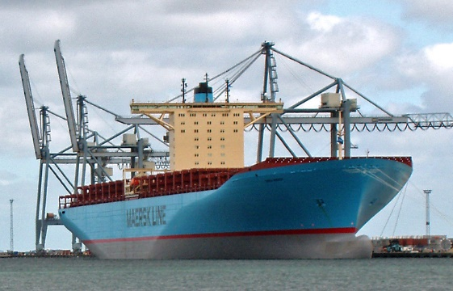
Ships
Design
Construction
Management
Loading
Scheduling
Route planning
Monitoring
Engine
Hull design
Pumps
Notes:
Large marine diesel engine (engineer at cylinder head 5). Container ship.

Slide 18


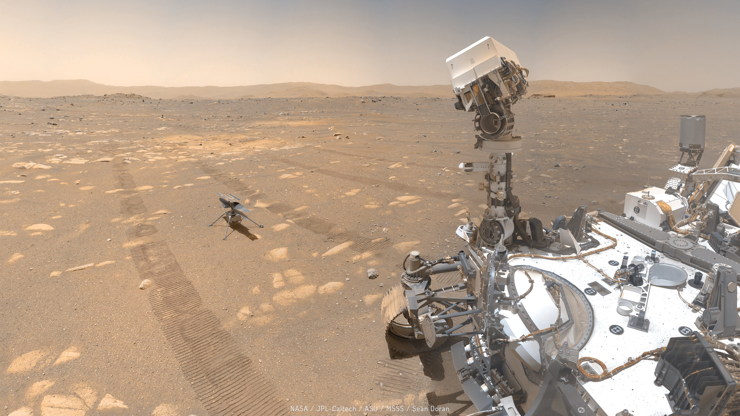
Aerospace
Communication
Control
Display
Routing
Signal processing
“Gadget” control
telemetry
Notes:
Mars rover and helicopter. Space X rocket launch

Slide 19

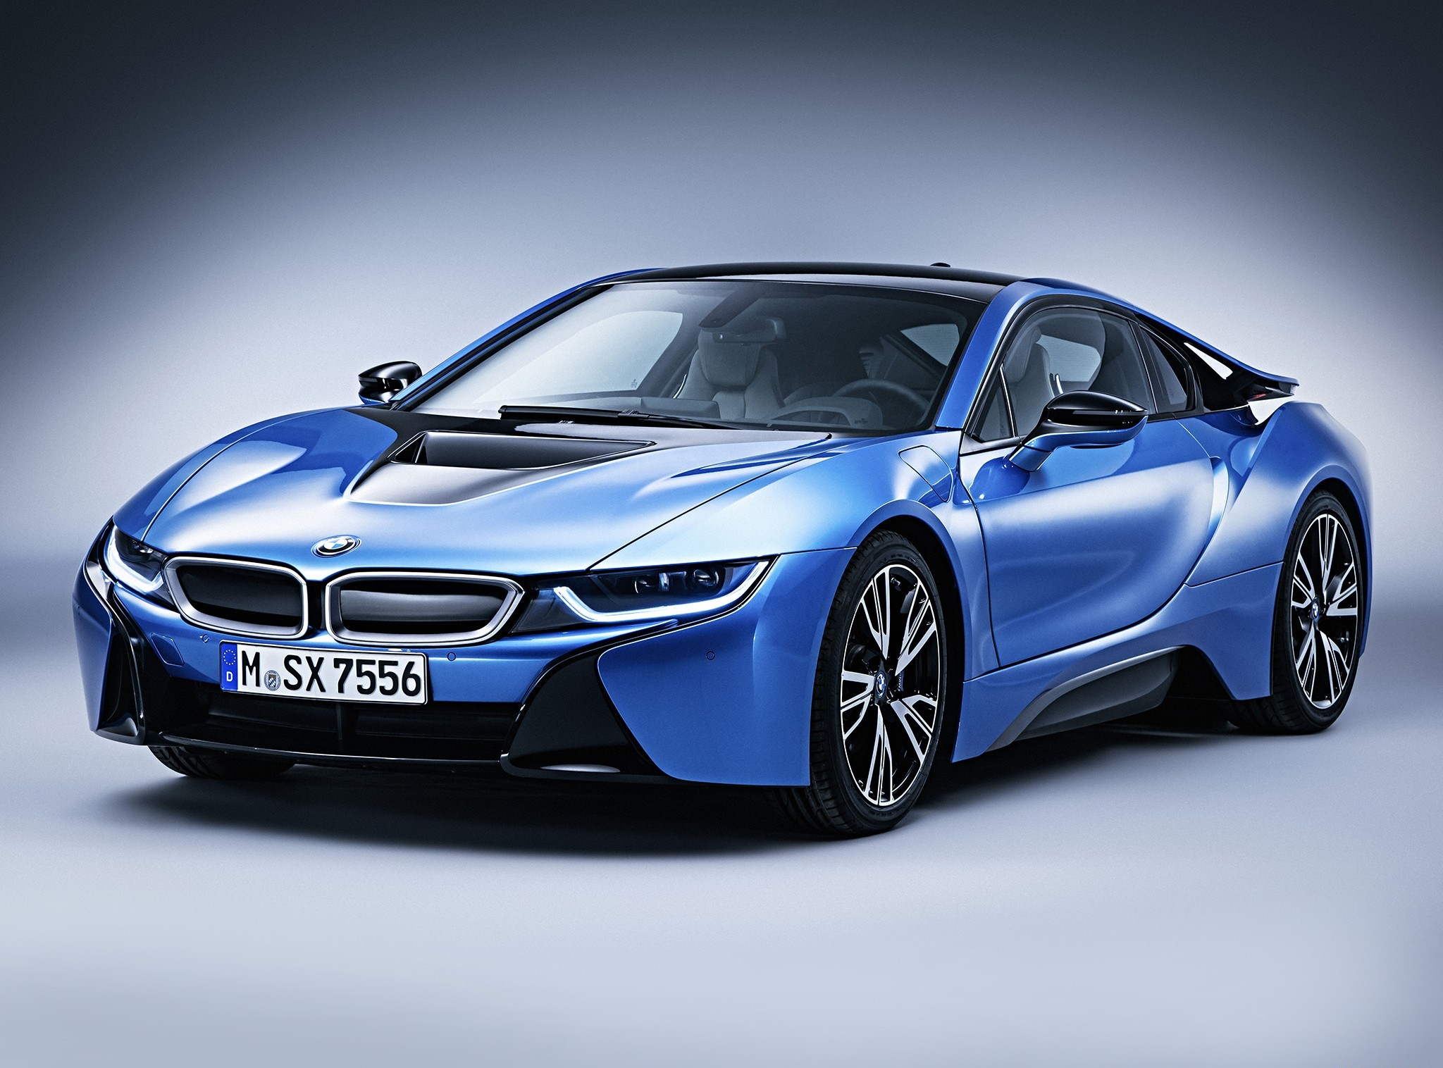
Cars (distributed computers with wheels)
Gas, diesel, hybrid, electric
Self-driving
Navigation
Entertainment
Design
Monitoring
Steering
Breaks

Slide 20
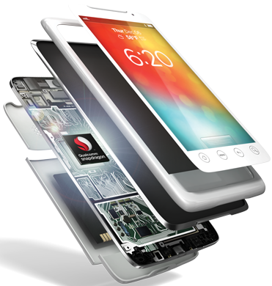
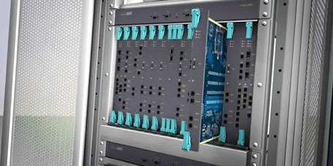
Phones
Switching
Reliability
Provisioning
Images
Videos
apps
Voice quality
User interfaces
Billing
Mobility

Slide 21

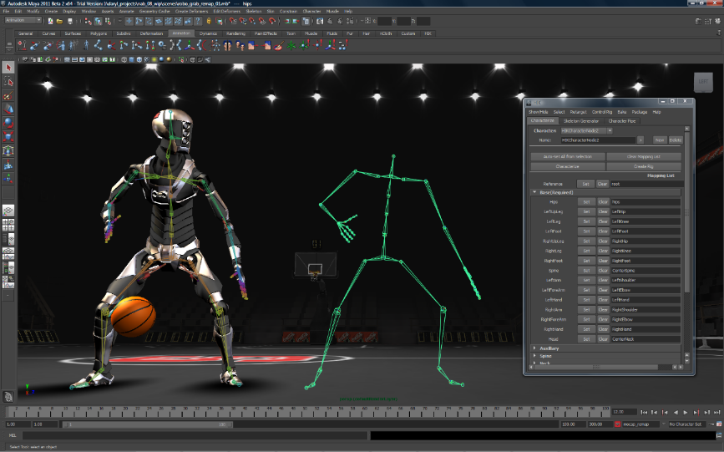
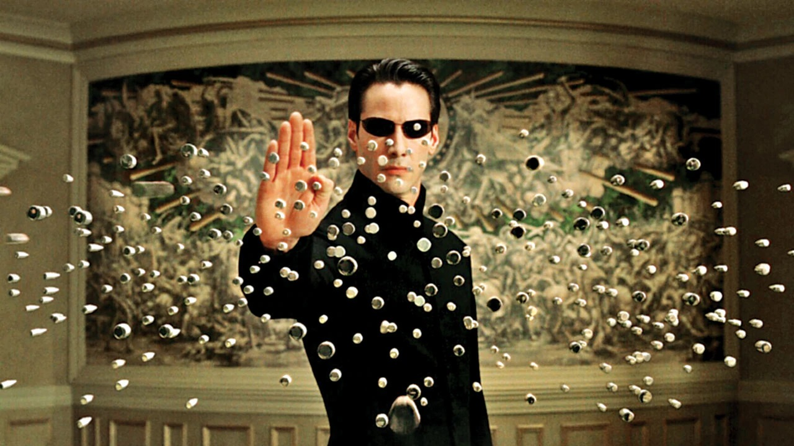


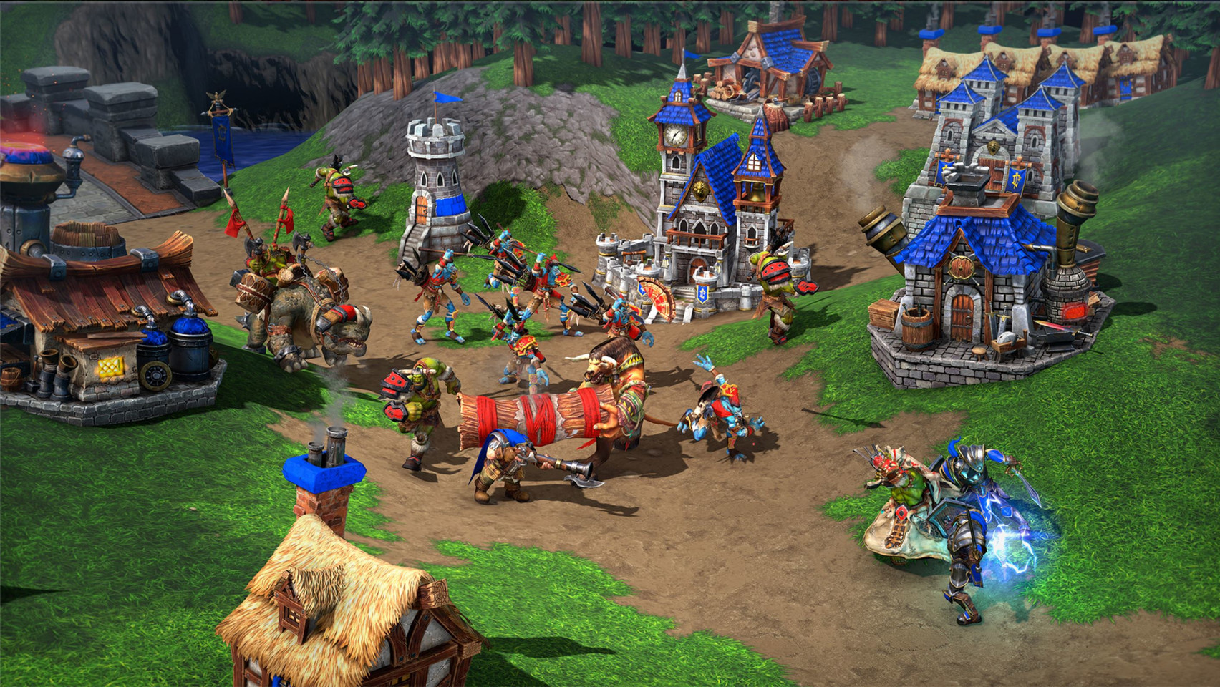

Graphics, animation, and games
Notes:
No, I am not a games expert. https://youtu.be/Ufp8weYYDE8?si=Wa5QPA0TsOxgK4Pt

Slide 22
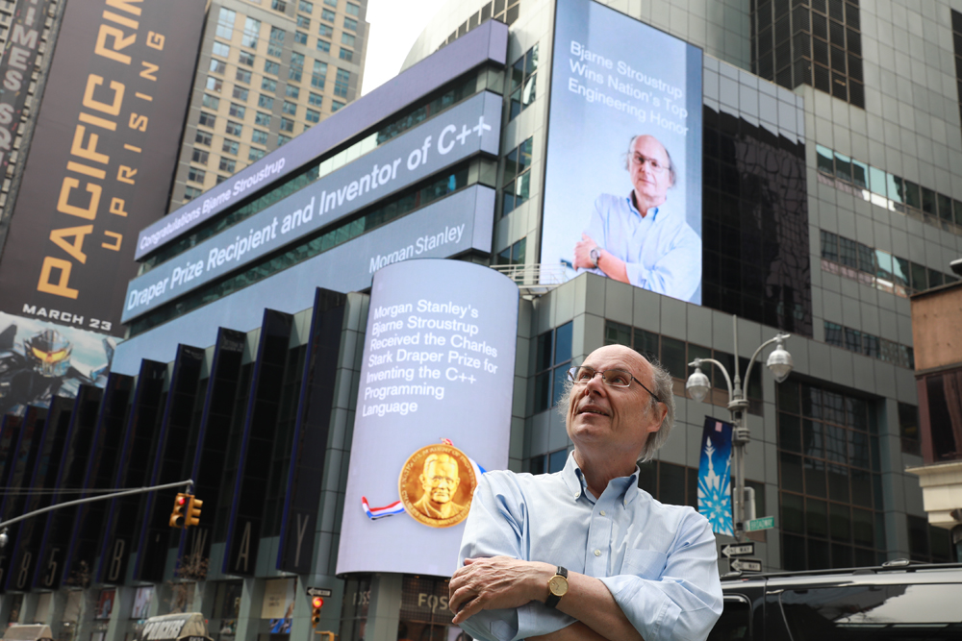

Commerce, finance, and governance
Banks
Stock exchanges
Currency exchange
Social services
Medical records
Taxes
Online stores
Notes:
Wall St. Morgan Stanley and Stroustrup’s Draper Prize.

Slide 23
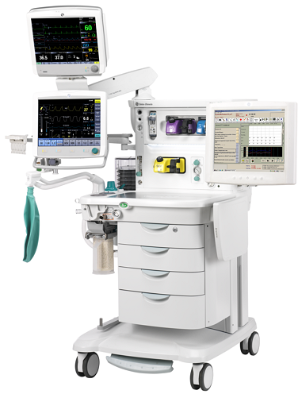

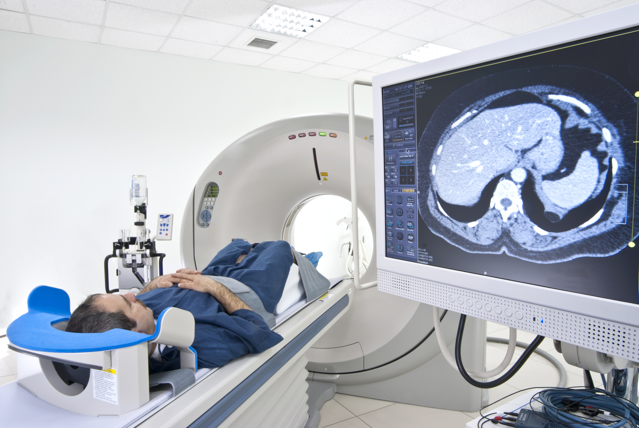
Medicine
Scanners
Vaccine development and production
Analysis (blood, tissue)
General research
Genomics
Materials design
Simulations
???
Notes:
Protein folding. Cat scanner with display. Dental scanner.

Slide 24
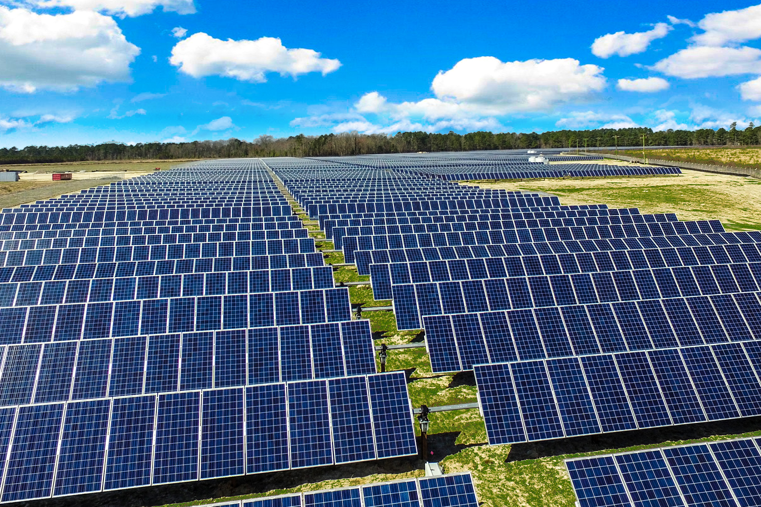


Energy
Control
Monitoring
Analysis
Design
Communications
Visualization
Manufacturing
Transport

Slide 25

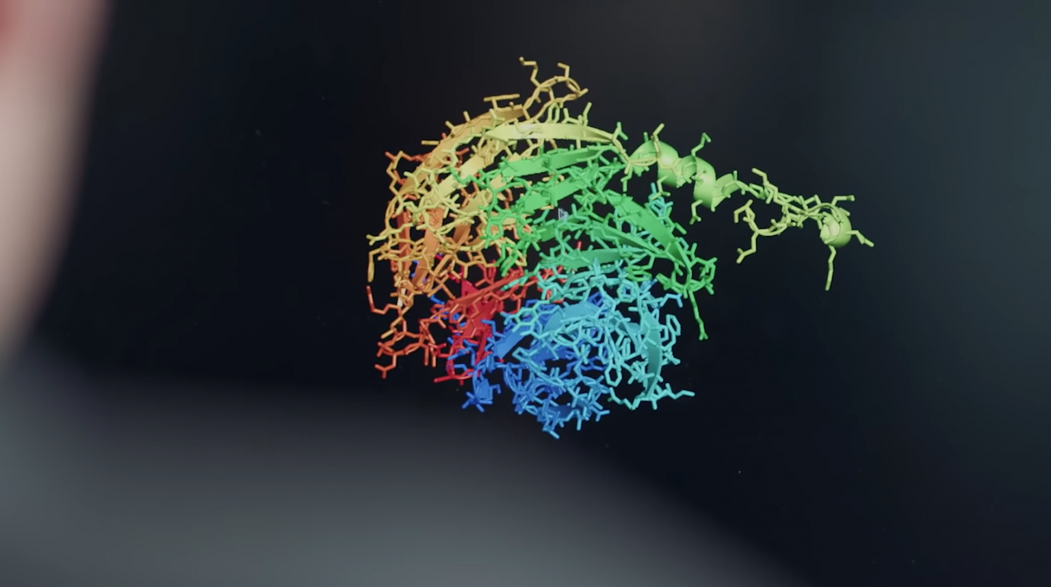
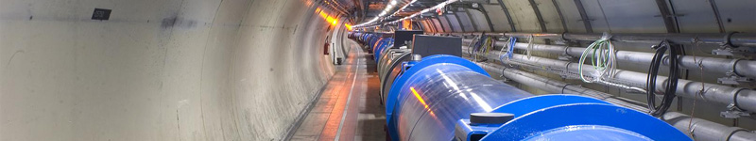
Science
Physics
Biology
Engineering
Astronomy

Slide 26
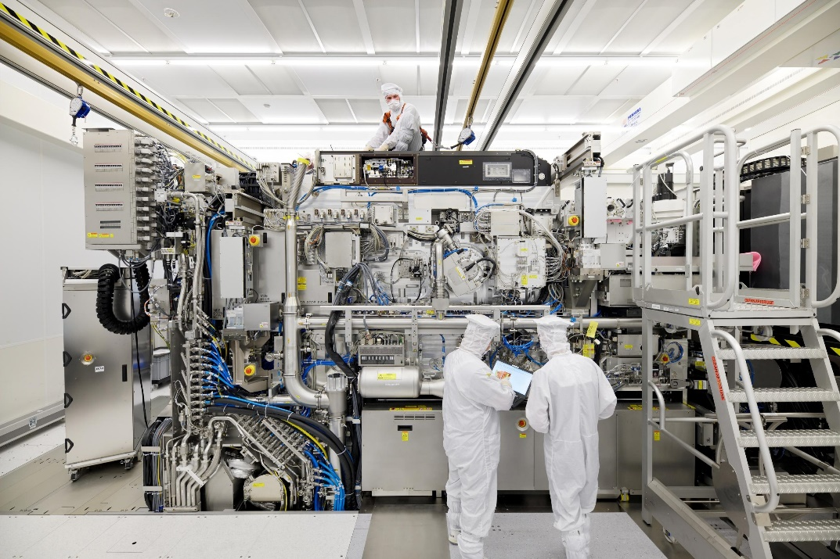
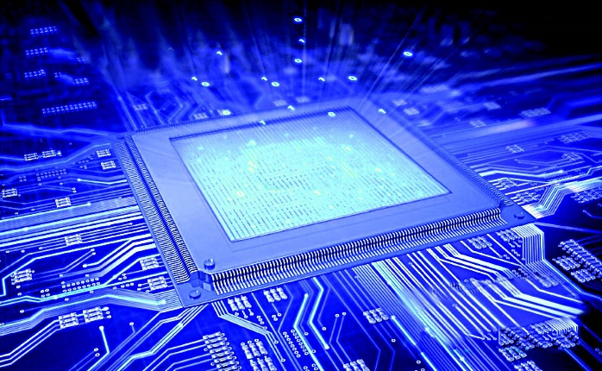
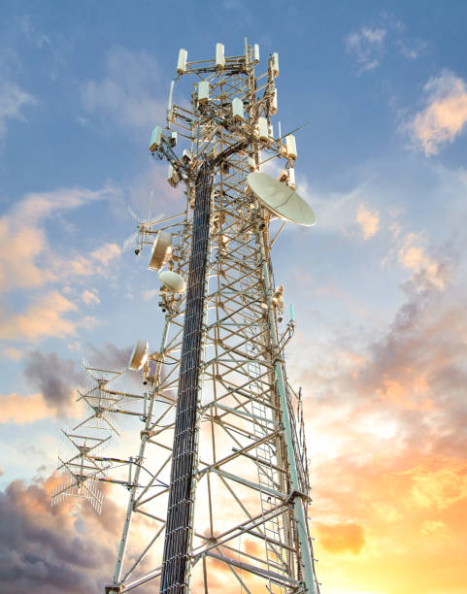
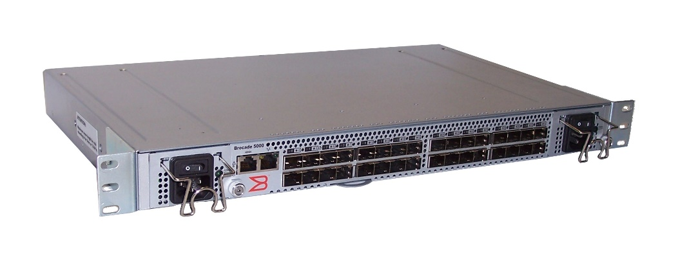
Foundations
Microelectronics
Computers
Routers
Networking
Manufacturing
Wireless
Operating systems
Browsers
Virtual machines
Search engines

Slide 27
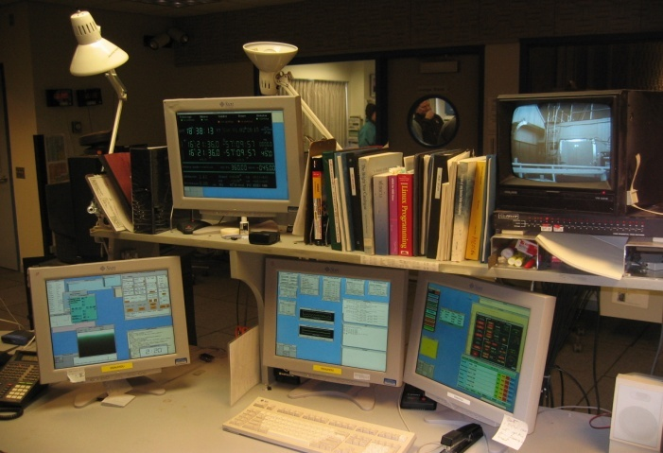

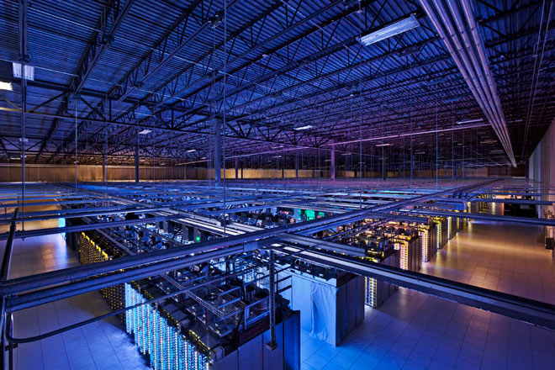
Laptops, tablets, workstations, servers, …
There’s a lot more to computing than games, word processing, browsing, and spreadsheets!
Notes:
Monitoring station for Keck telescope, Mauna Kea, Hawaii. Server farm

Slide 28
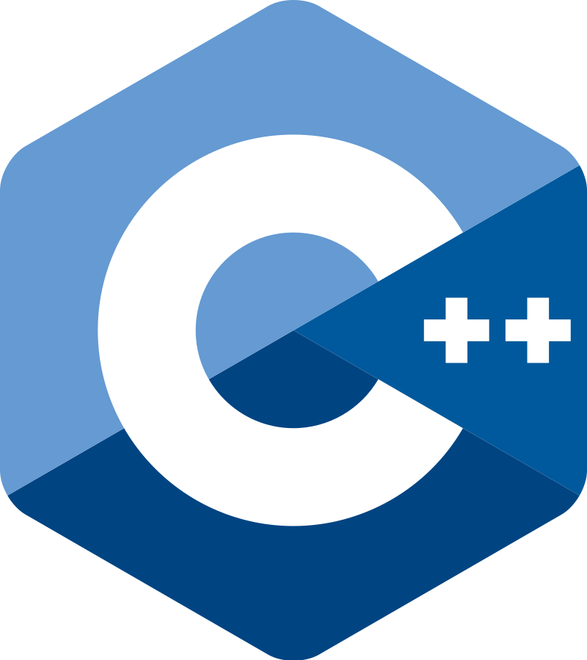
Why C++ ?
You can’t learn to program without a programming language
The purpose of a programming language is to allow you to express your ideas in code
C++ is the language that most directly allows you to express ideas from the largest number of application areas
C++ is the most widely used language in engineering areas
http://www.stroustrup.com/applications.html
Other languages often use C++ for computation intensive tasks
E.g., Python doing AI
The implementation of many languages are C++ programs
E.g., Java and Javascript

Slide 29
Why C++ ?
C++ is precisely and comprehensively defined by an ISO standard
And that standard is almost universally accepted
The most recent standard is ISO C++ 2023
C++ is available on almost all kinds of computers
Programming concepts that you learn using C++ can be used fairly directly in other languages
Including C, Java, C#, and (less directly) Fortran

Slide 30
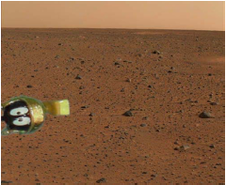

Where is C++ Used?
Just about everywhere
C++ plays a major part in all the examples and photos used here
See www.stroustrup.com/applications.html
Note: a large system is not written exclusively in one language
Notes:
Marvin, the martian

Slide 31
A first program – complete
// a first program:
import std; // get the standard library facilities
int main() // main() is where a C++ program starts
{
std::cout << "Hello, world!\n"; // output the 13 characters Hello, world!
// followed by a new line
return 0; // return a value indicating success
}
// note the semicolons; they terminate statements
// braces { … } group statements into a block
// main( ) is a function that takes no arguments ( ) and returns an integer result

Slide 32
A first program – older style
// a first program:
#include <iostream>; // get the library facilities needed for now
int main() // main() is where a C++ program starts
{
std::cout << "Hello, world!\n"; // output the 13 characters Hello, world!
// followed by a new line
return 0; // return a value indicating success
}
// the std:: says that cout comes from the standard library
// main( ) ‘s result indicate success (value 0) or failure (non zero value)

Slide 33
A first program – use while learning
// a first program:
#include “PPP.h” // get PPP support
int main() // main() is where a C++ program starts
{
cout << "Hello, world!\n"; // output the 13 characters Hello, world!
// followed by a new line
return 0; // return a value indicating success
}
// quotes delimit a string literal
// NOTE: “smart” quotes “ ” will cause compiler problems.
// \n is a notation for a new line
// for PPP.h, see www.stroustrup.com/Programming

Slide 34
A first program – older style
// a first program:
#include “PPPheaders.h" // get the PPP support on older C++ implementations
int main() // main() is where a C++ program starts
{
cout << "Hello, world!\n"; // output the 13 characters Hello, world!
// followed by a new line
return 0; // return a value indicating success
}
// note the semicolons; they terminate statements
// braces { … } group statements into a block
// main( ) is a function that takes no arguments ( )
// and returns an int (an integer value) to indicate success or failure

Slide 35
Hello, world!
“Hello world” is a very important program
Its purpose is to help you get used to your tools
Compiler
Program development environment
Program execution environment
Type in the program carefully
After you get it to work, please make a few mistakes to see how the tools respond; for example
Forget the header
Forget to terminate the string
Misspell return (e.g., retrun)
Forget a semicolon
Forget { or }
…

Slide 36
Hello world
It’s almost all “boiler plate”
Only cout << "Hello, world!\n" directly does anything
That’s normal
Most of our code, and most of the systems we use simply exist to make some other code elegant and/or efficient
“real world” non-software analogies abound
“Boiler plate,” that is, notation, libraries, and other support is what makes our code simple, comprehensible, trustworthy, and efficient.
Would you rather write 1,000,000 lines of machine code?
This implies that we should not just “get things done”; we should take great care that things are done elegantly, correctly, and in ways that ease the creation of more/other software:
Style Matters!

Slide 37
Compilation and linking
C++ source code
C++ compiler
Object code
linker
Executable program
Library Object code
You write C++ source code (e.g. Hello.cpp)
Source code is (in principle) human readable
The compiler translates what you wrote into object code (e.g., Hello.o)
sometimes called machine code
Object code is simple enough for a computer to “understand”
The linker links your code to other code needed for it to execute
E.g., input/output libraries, operating system code, and windowing code
The result is an executable program
E.g., a .exe file on windows or an a.out file on Linux

Slide 38
So what is programming?
Conventional definitions
Telling a very fast moron exactly what to do
A plan for solving a problem on a computer
Specifying the order of a program execution
But modern programs often involve millions of lines of code
And manipulation of data is central
Definition from another domain (academia)
A … program is an organized and directed accumulation of resources to accomplish specific … objectives …
Good, but no mention of actually doing anything
The definition we’ll use
Specifying the structure and behavior of a program, and testing that the program performs its task correctly and with acceptable performance
Never forget to check that “it” works
Software == one or more programs

Slide 39
Programming
Programming is fundamentally simple
Just state what the machine is to do
So why is programming hard?
We want “the machine” to do complex things
And computers are nitpicking, unforgiving, dumb beasts
The world is more complex than we’d like to believe
So we don’t always know the implications of what we want
“Programming is understanding”
When you can program a task, you understand it
When you program, you spend significant time trying to understand the task you want to automate
Programming is part practical, part theory
If you are just practical, you produce non-scalable unmaintainable hacks
If you are just theoretical, you produce toys

Slide 40
Support
Rely on local support, if available
A C++ implementation (good and free)
Clang, GCC, Microsoft, or other
Always use the most recent version
don’t suffer problems that “they” have already fixed
Have the contemporary language features and library components available
A Software development environment
Visual studio, visual studio code, X-code, or other
Or work from the command line
Online compiler: e.g., https://godbolt.org/
Online reference manual: https://en.cppreference.com/w/
Supporting libraries: www.stroustrup.com/programming.html

Slide 41
The next lecture
Will talk about types, values, variables, declarations, simple input and output, very simple computations, and type safety.

